Slide 1

WCA & Electronic Arts Datathon
Webinar Kickoff Call
February 24, 2020

Slide 2

K
Electronic Arts
Kevin Maher, VP – Analytics, Data Science, and Analytics Solutions
Ben Medler, Principal Data Scientist
WCA
Kayleigh Smoot, Associate Research & Education Director
Matt Gray, Senior Associate Director, Operations
Notes:
Matt

Slide 3

EA ranked as a Top Entertainment Company by Fortune’s list of the World’s Most Admired Companies
Some of our famous games are FIFA, SIMS, Madden, Battlefield, Apex Legends
Our analytical and data science community at EA develop frameworks that deliver actionable insights to our studios and game teams
Notes:
EA

Slide 4






Our Studios
GLOBAL ANALYTICS
& INSIGHTS
As well as…
Respawn
Criterion
Motive Studios
PopCap
Capital Games
Fire Monkeys
Chillingo
And many more…
Notes:
EA

Slide 5
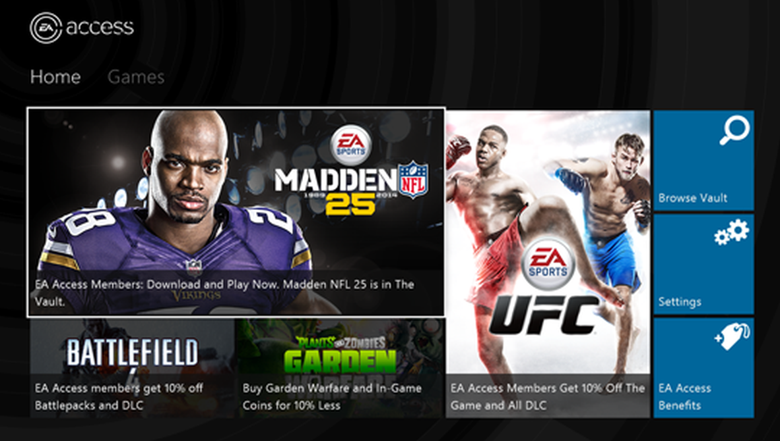
Business Model & Challenges
As game companies move towards providing subscription services, it’s becoming more important to match players with games that they will like
We are looking for ways to achieve better recommendations using innovative methods
Notes:
EA

Slide 6




Recommendations: Better Game Attributes
We would like to explore feature engineering extra variables to describe the perception of games from public sources of data
Are there novel ways to extract variables from publicly available datasets?
Do perceptions of games change over time, before and after launch?
Can our recommendation system react to changes in opinions over time?
Game Launch
Notes:
EA

Slide 7
Datathon Challenges
Consistent with a real-life business problem, there is no prescribed approach, with teams free to exercise judgement on areas they feel will release the most value from the available data. Ideas include, but are not limited to:
Better game attributes
Are there novel ways to extract variables describing games from publicly available spaces such as Wikipedia, Metacritic, Twitter, Instagram, etc. to enrich our data about the games?
Do perceptions of games change over time (e.g. before and after launch) and should this be included in our recommendation models?
The features may be textual (topic modeling, doc2vec, sentiment), temporal (Twitter volume, game’s subreddit subscribers, sentiment over time), or any other useful signal.
New versus experienced players
How to find solutions that can predict for entire player base or create separate models for newcomers while leveraging veteran player history data to create a separate model?
How to maximize individual game and subscription service ROI
How to get users convert from a free trial to monthly to annual subscriptions
How to get players to play new or more games (even non-EA titles)
Notes:
EA

Slide 8
Data Overview
The data contains users who are subscribed to Origin Access and their activity with the games both within and without the subscription catalogue (aka, “vault”). Not all datasets are within the same time window due to tracking systems being turned on at different times. However, part of the research is to hopefully still leverage the historical activity with the more complete recent view.
Tables include: User subscription windows, origin access vault games, game sessions, game entitlements, game launches, and game descriptions.
Teams are encouraged to feature engineer from third-party sources to augment this dataset – i.e. Reddit, Wikipedia, Metacritic, game databases, etc.
Notes:
EA

Slide 9
Data Tables
User Subscription Windows
data_sub.csv: This is a sample (scaled to obfuscate) of users who have subscribed to Origin Access from 2016-01 until 2018-06. Each user can subscribe multiple times with different types of subscriptions (trial, monthly, annual) and different lapsed windows.
Origin Access Vault Games
data_oa_vault.csv: This is the catalog of games within the Origin Access subscription game vault along with when the game was included. It also has trial dates which allows user to play free trials before purchasing.
Game Description
data_games.csv: This is the dictionary of games and their description. Use this to join onto the other datasets by the field game_title in order to get game information.
Notes:
EA

Slide 10
Data Tables
Game Entitlements
data_entitlements.csv: This is the first time a user opened a game. Users can purchase a game, but they wont be entitled until they actually install and open the game, which is recorded here. This includes games that users have purchased as well as games they have access through their Origin Access subscription. This also includes games they have on other platforms such as XBOX and Playstation
Game Launches
data_game_launch.csv: This is a new hook to capture game start and stop from the timestamp level. It starts at 2018-02 until current. It records where the game was launched from the Origin client or the game’s .exe executable directly. It also records a session_id which means when a user logged into Origin and played a string of games in sequence will all have the same session_id until they log off of Origin. The difference between this and the data_session.csv is that whereas data_session.csv is only Origin Access games, this is all games.
Game Sessions
data_session.csv: This is the daily user sessions for a game within the Origin Access game vault only. Every time a user plays a game within their subscription period and it is an Origin Access vault game, it will generate a record for that day. If a user plays the same game over multiple days, it will create multiple records for each day and game.Game Entitlements
Notes:
EA

Slide 11
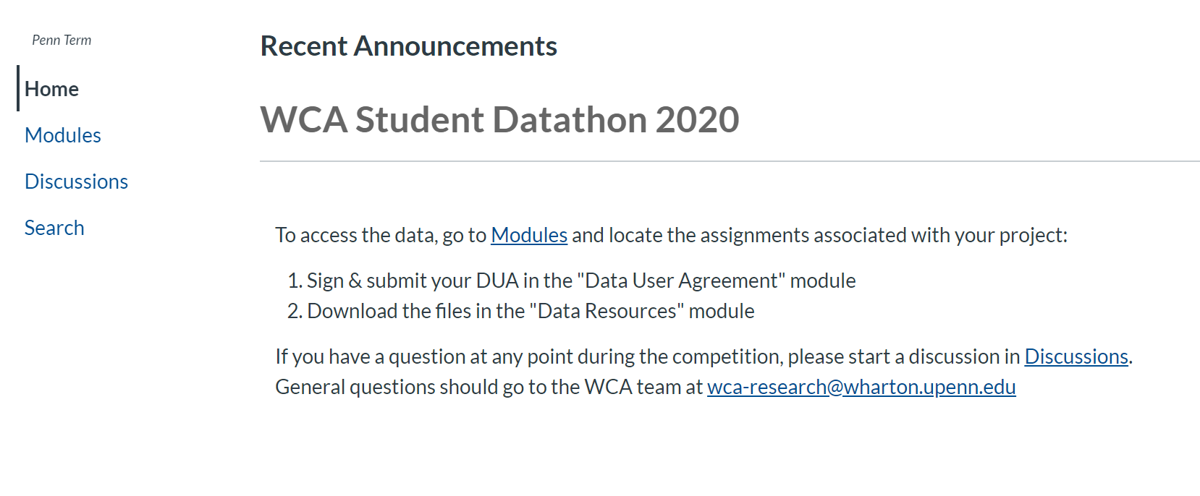
How to Access the Data
You have been added to the "WCA Student Datathon” course on Canvas
To access the data, go to “Modules”
Notes:
Kayleigh

Slide 12
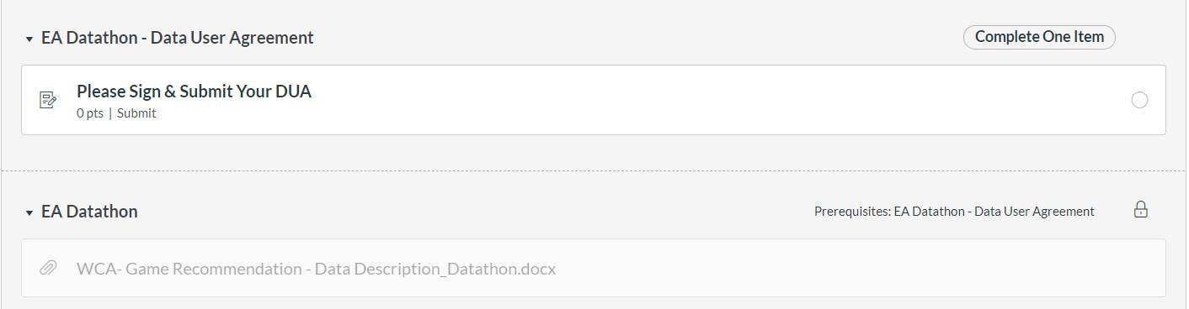
How to Sign the Data User Agreement
Locate the modules associated with Electronic Arts
Sign & submit your DUA
Notes:
Kayleigh

Slide 13
Data User Agreement Terms
Please do not share or discuss the data details with anyone not participating in the datathon
Delete the data files at the end of datathon
Notes:
Kayleigh

Slide 14
Deliverables & Judging Criteria
Students will deliver presentation materials, data visualizations, and code.
The sponsor will consider the potential value to be created, along with the sophistication and creativity of any solution. Students are encouraged to consider the credibility and ease of implementation of any approach, relative to the solutions they identify.
Student teams will be judged on the following:
Quality of approach and methodology
Analysis of results and potential business impact
Ease of implementation
Translation & presentation of results to the audience
Notes:
Matt/EA

Slide 15
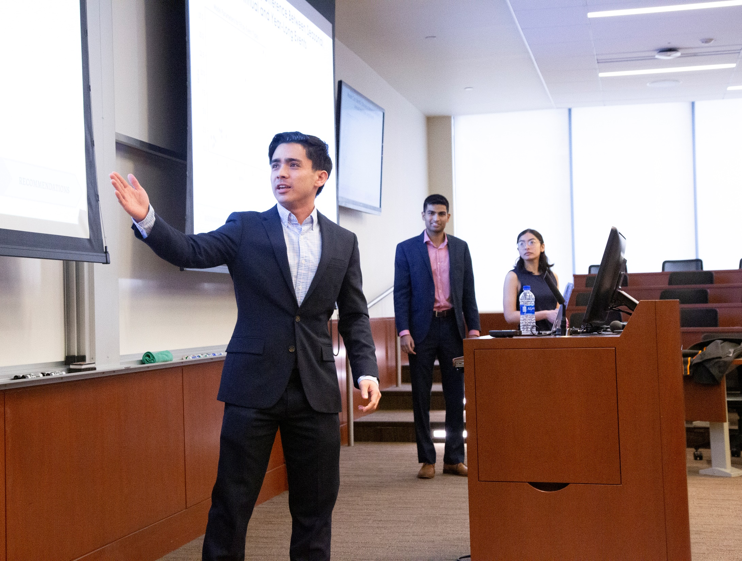
Datathon Timeline
Feb 24, 2020 Datathon kick off webinar and teams given access to data; Office hours for questions
Feb 24 - 28 Student teams work
Feb 27 and 28 Open office hours and “Career Chats” with EA (sign-up TBA)
Feb 28, 2020 Datathon Main Event - student presentations to EA and winners selected from judge’s panel made up of EA and WCA leadership
Prizes include:
1st Place: Per Team Participant - $200 Visa Gift Card, Origin PC Premier for a Year, and Dinner with EA Executives
2nd Place: Per Team Participant - $100 Visa Gift Card + Origin PC Premier for a Year.
3rd Place: Per Team Participant - Origin PC Premier for a Year.
Notes:
Matt

Slide 16
Final Presentation Day Agenda
Friday, February 28, 2020
Jon M. Huntsman Hall, F85
11:00 – 11:30 AM Arrival and Lunch
11:30 – 12:00 PM Welcome from WCA and Electronic Arts
12:00 – 02:00 PM Student Presentations
02:00 – 02:45 PM Judges Deliberation
02:45 – 03:00 PM Winners Announced
03:00 – 04:00 PM Networking Reception
Notes:
Matt

Slide 17
Questions?
Each team will be called upon in order to ask questions, please be ready when your team has been called upon.
Notes:
Matt

Slide 18
Webinar Recording
You can access the webinar recording here: https://bluejeans.com/s/OVGy7/
Please note: The recording begins at ~24 minutes in
Notes:
Matt

Slide 19


